Slide 1
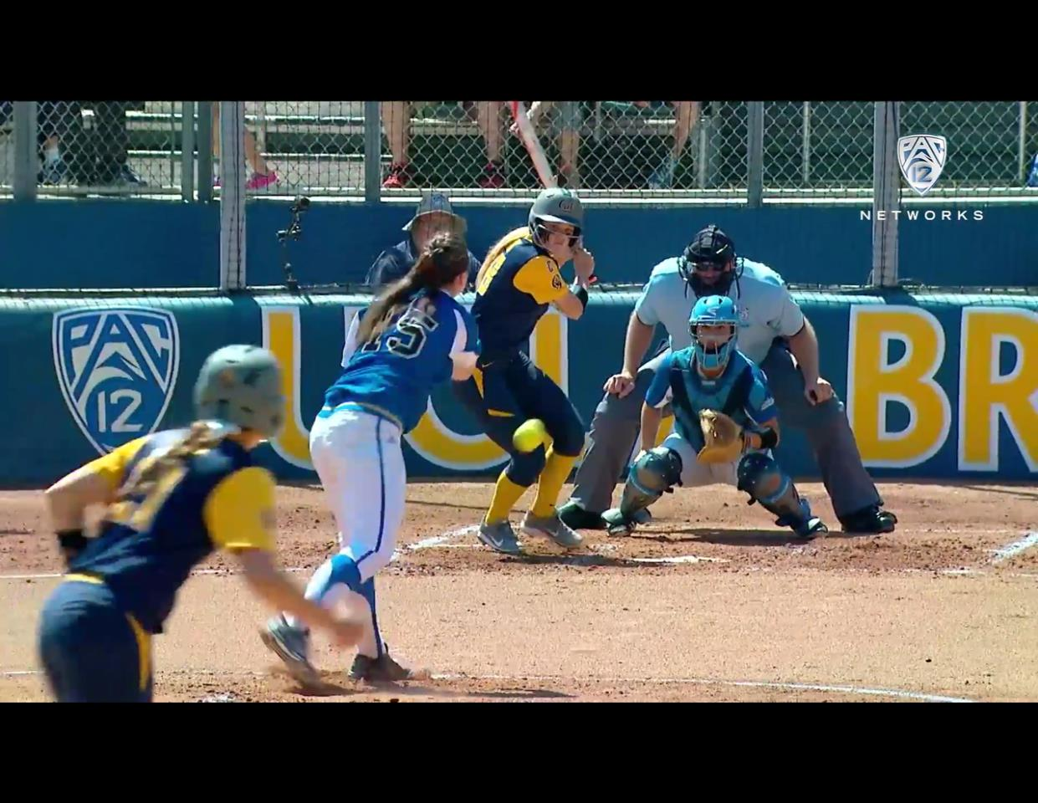
Good First Impressions Uniform Gear Bag
Preparing for the 2021 Season

Slide 2
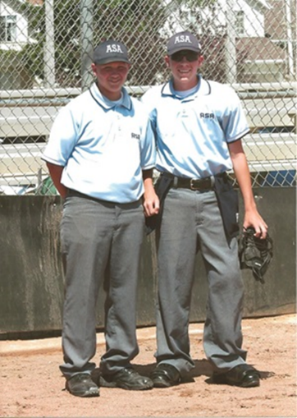
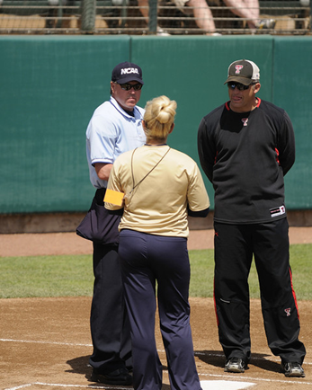
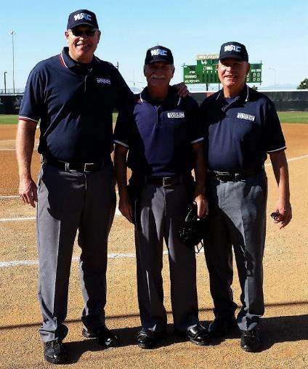
First Impressions
Dress and maintain your appearance in a manner befitting the dignity and importance of the umpire.

Slide 3
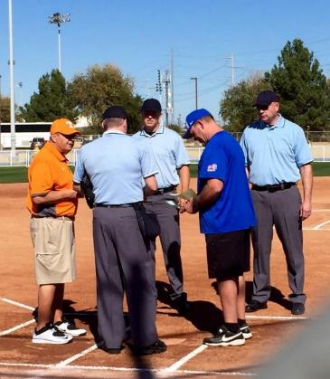
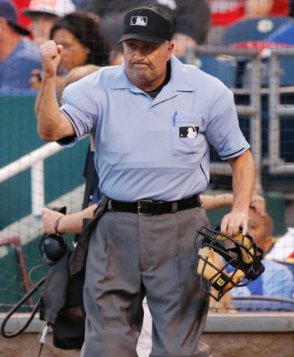
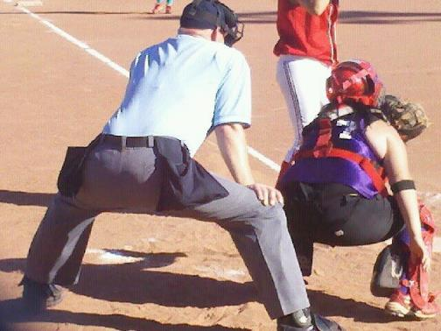
First Impressions
To be a successful umpire, you will have to be proficient in appearance, rule knowledge, mechanics and game management.

Slide 4
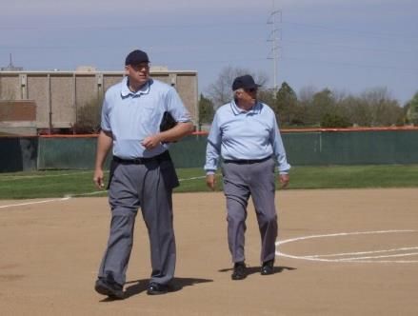
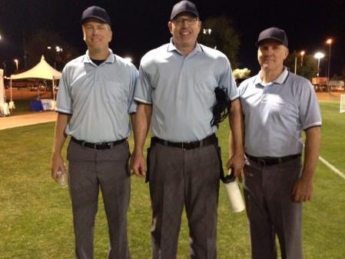
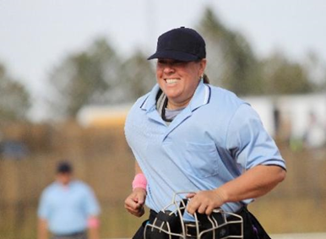
First Impressions
Game management starts when the players and spectators watch you take the field.

Slide 5
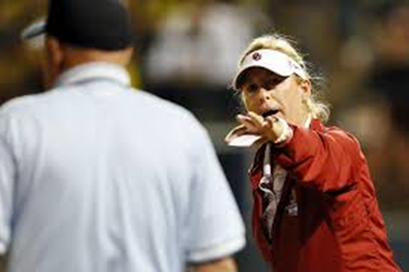
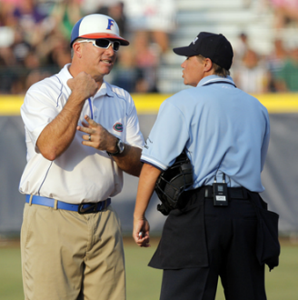
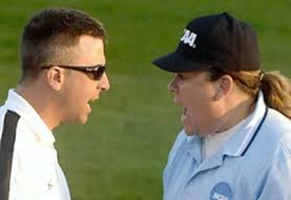

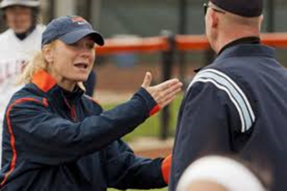
First Impressions
Game management starts when the players and spectators watch you take the field.

Slide 6
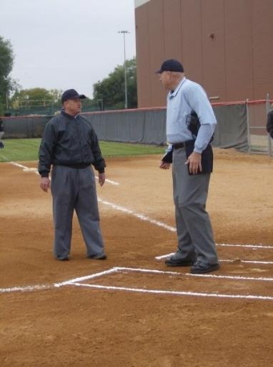
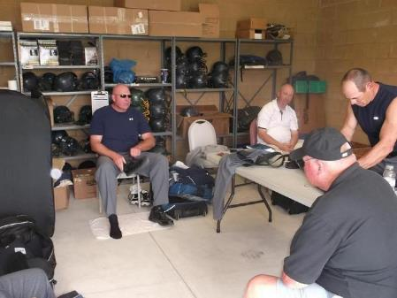
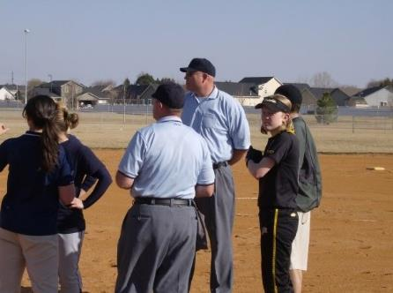
First Impressions
First impressions are so important — sometimes even in the parking lot, or any other time we talk with our partner(s).

Slide 7
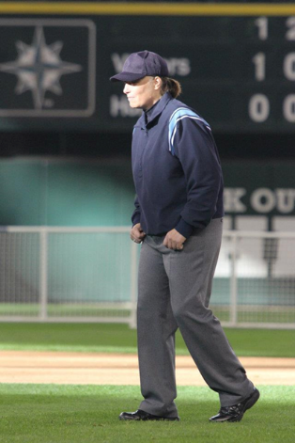
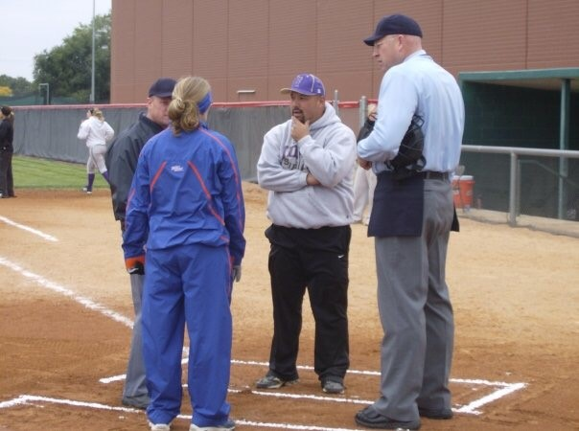
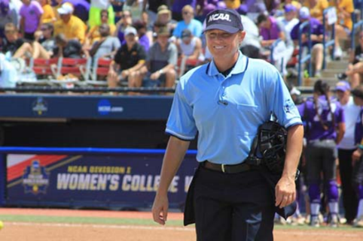
First Impressions
"You will never get a second chance to make a first impression!"
Your appearance should be impeccable and your pregame
duties performed in a friendly yet business-like manner.

Slide 8
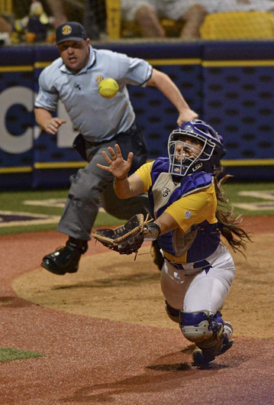
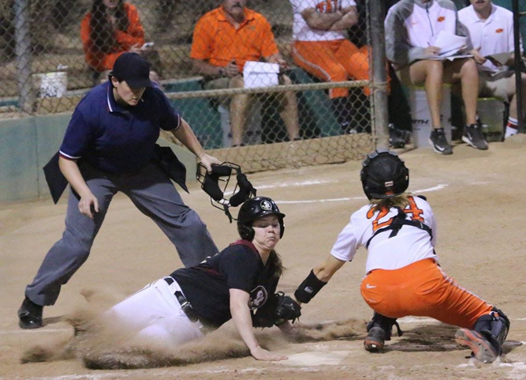
Uniform and Equipment
The appearance of officials is most important, for both the respect of players, coaches and spectators, as well as for comfort and safety.

Slide 9
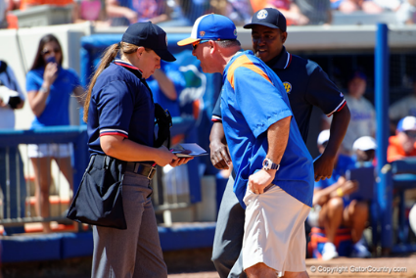
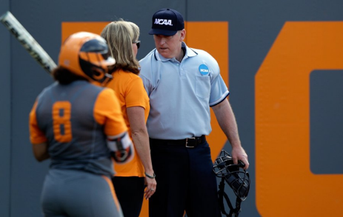
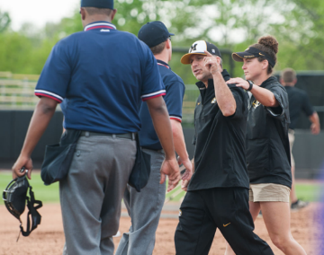
Appearance is so much more than the uniform we wear
“The appearance of officials is most important, for both the respect of players coaches and spectators, as well as for comfort and safety.”

Slide 10
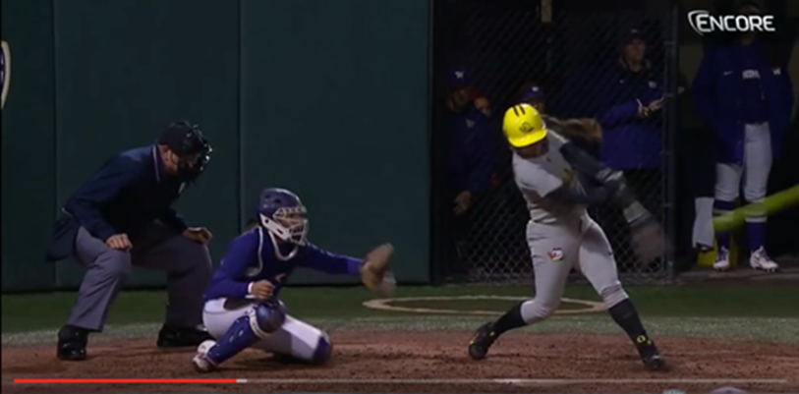
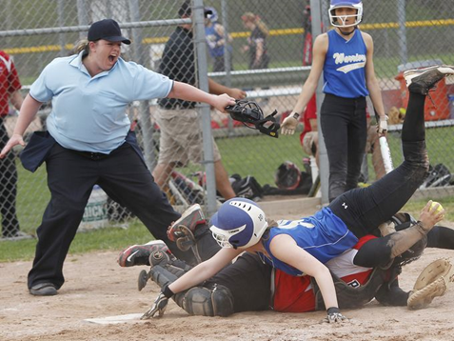
Appearance is so much more than the uniform we wear
“The appearance of officials is most important, for both the respect of players coaches and spectators, as well as for comfort and safety.”

Slide 12
Uniform and Equipment
It is imperative that all umpires wear identical color combinations
The proper uniform for an umpire consists of a powder blue shirt (pullover or button style) Navy Blue Shirt is approved in our local High School Association. Confirm prior to arrival that the Navy shirt is the color of choice
If an undershirt is worn under the powder blue shirt, it shall be white and short sleeved. Undershirt worn under Navy is always Navy. If a long-sleeve undershirt or turtleneck is worn, it shall not be exposed.
Heather gray or navy blue slacks are approved Nationally, our association has designated the heather gray pant as our pant color. Slacks should fit comfortably over leg guards. Plate pants. Flat front pant is approved
A black belt with a small silver buckle completes the uniform
Navy blue fitted cap, The fitted cap is mandatory and shall never be worn backwards. Clean and free from stains or dirt
Pullover style jackets or knit sweaters shall be solid navy blue. No patch other than the state association patch shall be worn on the uniform. ¾ sleeve is approved for Third District

Slide 13
Uniform and Equipment
Equipment for the plate umpire should offer the best in protection, mobility and comfort.
A mask with a throat protector is required in F.P. Invest in WENDY Pads
The inside-style chest protector and leg guards are strongly recommended
Shoes for the plate umpire should offer the maximum in protection with a hard shell or steel reinforced toe and steel or reinforced tongue. Soles should provide good traction.
Shoes should be solid black with no white or colored markings.
Navy or black socks that are at least midcalf length should be worn.
The plate and base umpire(s) should use an indicator and plate/base brush.
A ball bag the color of the slacks is mandatory for the plate umpire. Navy bags are acceptable with Gray slacks

Slide 14
Uniform and Equipment
Umpire(s) should dress according to weather conditions and have additional or backup equipment at their disposal.
Male umpires shall wear a protective cup.
State associations may adopt other uniform options, as long it does not comprise the umpire(s) safety and all umpires are dressed alike. IE Navy Ball Bags with heather gray slacks
Jewelry, except for medical-alert bracelets and necklaces, shall not be worn.

Slide 15
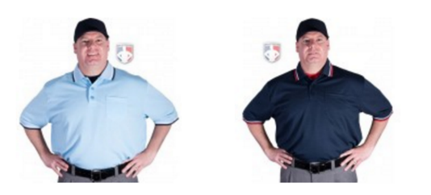
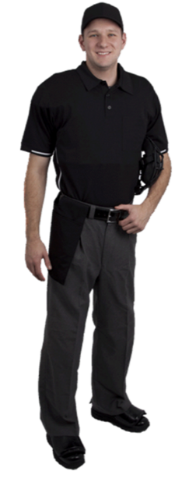
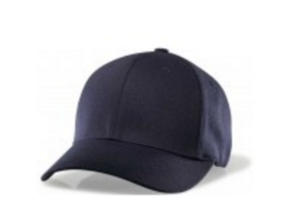
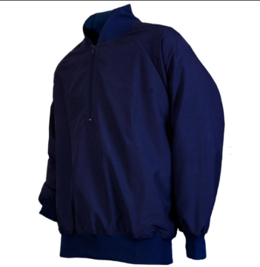
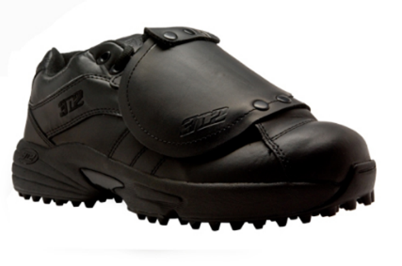
Uniform and Equipment

Slide 16


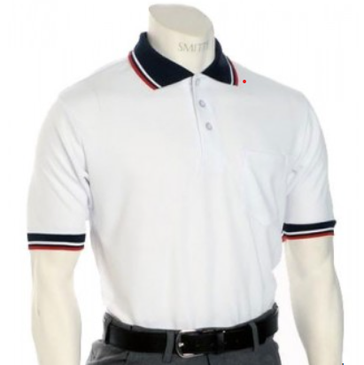
Uniform and Equipment Another Shirt Option

Slide 17
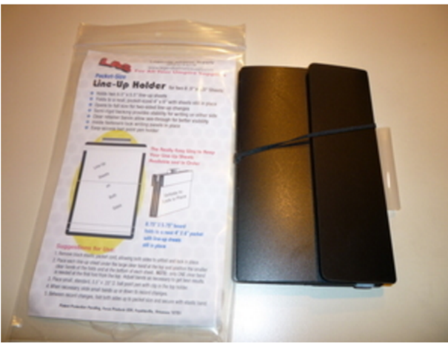
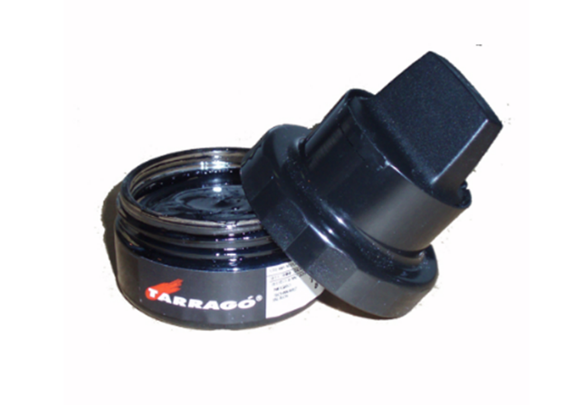
Uniform and Equipment

Slide 18

Uniform and Equipment
Designed with the same expertise used to develop the US military’s preferred helmet pads, Team Wendy's UMPS™ umpire mask replacement padding is lightweight and comfortable. It's the first commercially available padding designed using Zorbium® foam, known for significantly lowering the impact severity index and peak acceleration forces. Product Details
Manages impact up to 40% more effectively than other commercially available umpire face mask pads
Lowers peak acceleration forces up to 30% better than similar products
Made with Team Wendy's energy-absorbing Zorbium foam
Machine washable and quick drying material
Covered with soft, moisture-wicking, anti-microbial microfiber fabric
Available in Black or Tan

Slide 19
Uniform and Equipment
Lets Talk Gear Bags…

Slide 20
Uniform and Equipment
BSUAuniforms@cableone.net
Ump-attire.com (All)
Gerydavis.com (Pants)
Smittyapparel.com (Smitty Shirts)
Officialgear.com (USA Softball)
Purchaseofficials.com (All)
Honigs.com (All)
NFHSofficialsstore.com (All)
Umpjunk.com (Line up card holder)

Slide 21
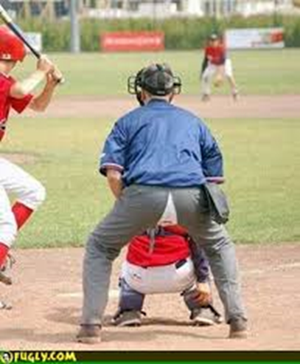
Don’t Be That Umpire…

